Slide 1

Identifying and improving telco customer churn
Leo Luera
DSC 630 Predictive Analytics
March 8, 2026

Slide 2
Agenda
Introduction of the problem
Data overview
Methods of analysis
Results and findings
Conclusion

Slide 3
introduction
In subscription-based industries, customer churn poses a persistent challenge due to high competition, low switching costs, and growing value-added services.
Predictive analytics provides an opportunity to anticipate churn behavior before it occurs, enabling organizations to take proactive steps to retain customers.
Predicting human behavior is not a simple task, however this proposal outlines a predictive analytics project focused on customer churn using the IBM Telco Customer Churn dataset.

Slide 4
Goal
This effort seeks to demonstrate how predictive analytics can be translated into actionable business recommendations that support customer retention efforts.
Which customer, contract, and service attributes are most strongly associated with churn in this dataset?
How well can a classification model distinguish churners from non-churners, especially in terms of recall for churners?
How might the model’s insights inform concrete retention strategies?

Slide 5
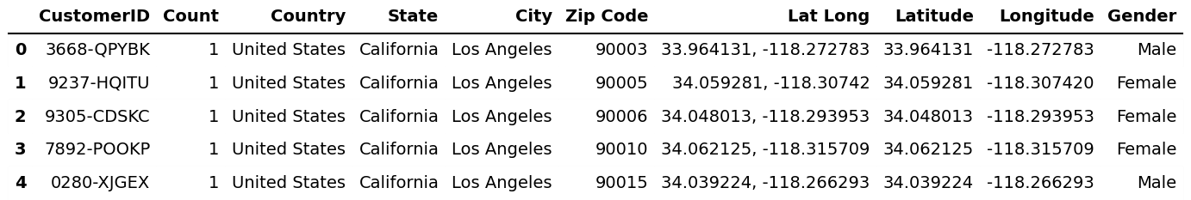
Data overview
CustomerID
County
Country
State
City
Zip Code
Lat Long
Latitude
Longitude
Gender
Senior Citizen
Partner
Dependents
Tenure Months
Phone Service
Multiple Lines
Internet Service
Online Security
Online Backup
Device Protection
Tech Support
Streaming TV
Streaming Movies
Contract
Paperless Billing
Payment Method
Monthly Charges
Total Charges
Churn Label
Churn Value
Churn Score
CLTV
Churn Reason

Slide 6
Methods of analysis
(Data Cleaning)
Number Encoding​
Encoded the Churn Label target variable into a new, binary variable for modeling.
Dropped Columns
Removed unnecessary columns for modeling:
- CustomerID
- Count
- Churn Label
- Churn Score
- CLTV
- Churn Reason
Convert to Numeric
Ensured Total Charges column was numeric.

Slide 7
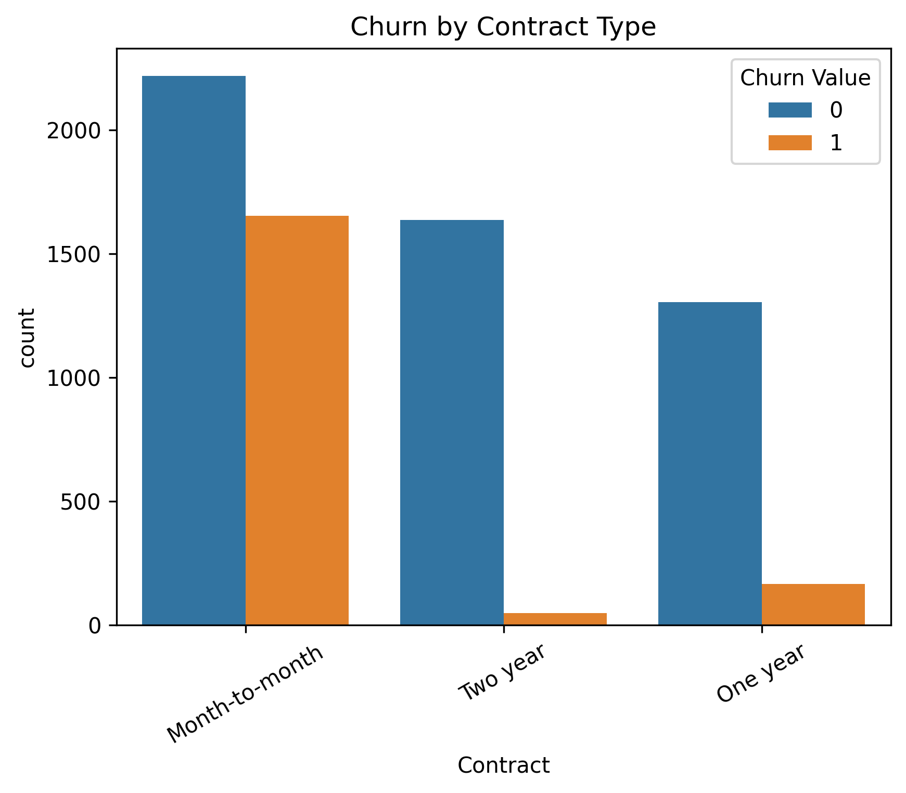
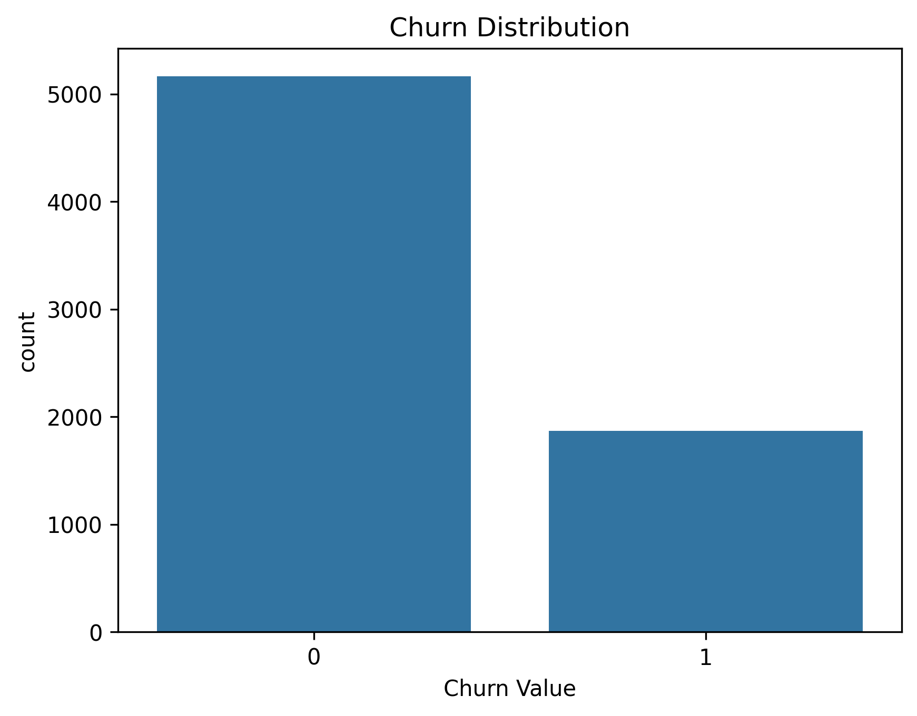
Methods of analysis
(EDA)
Customer Stayed
Customer Left

Slide 8
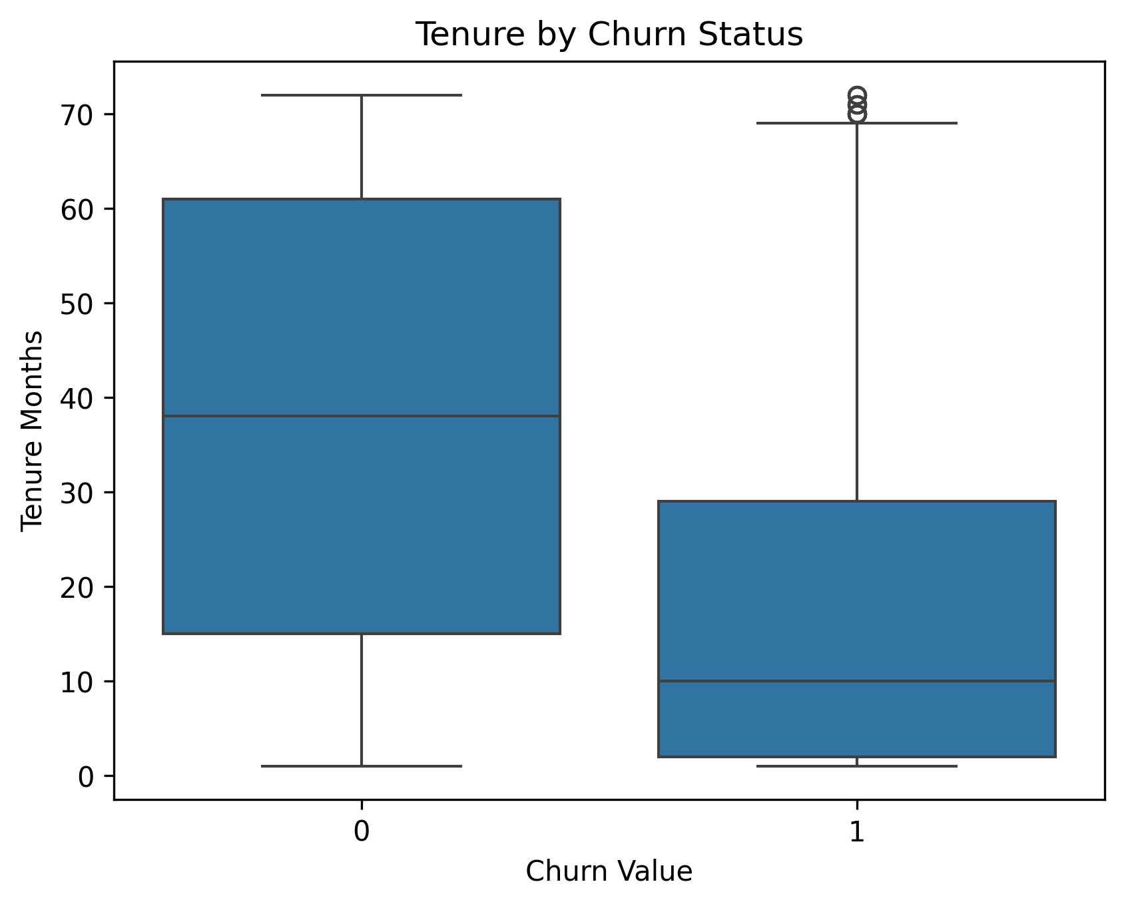
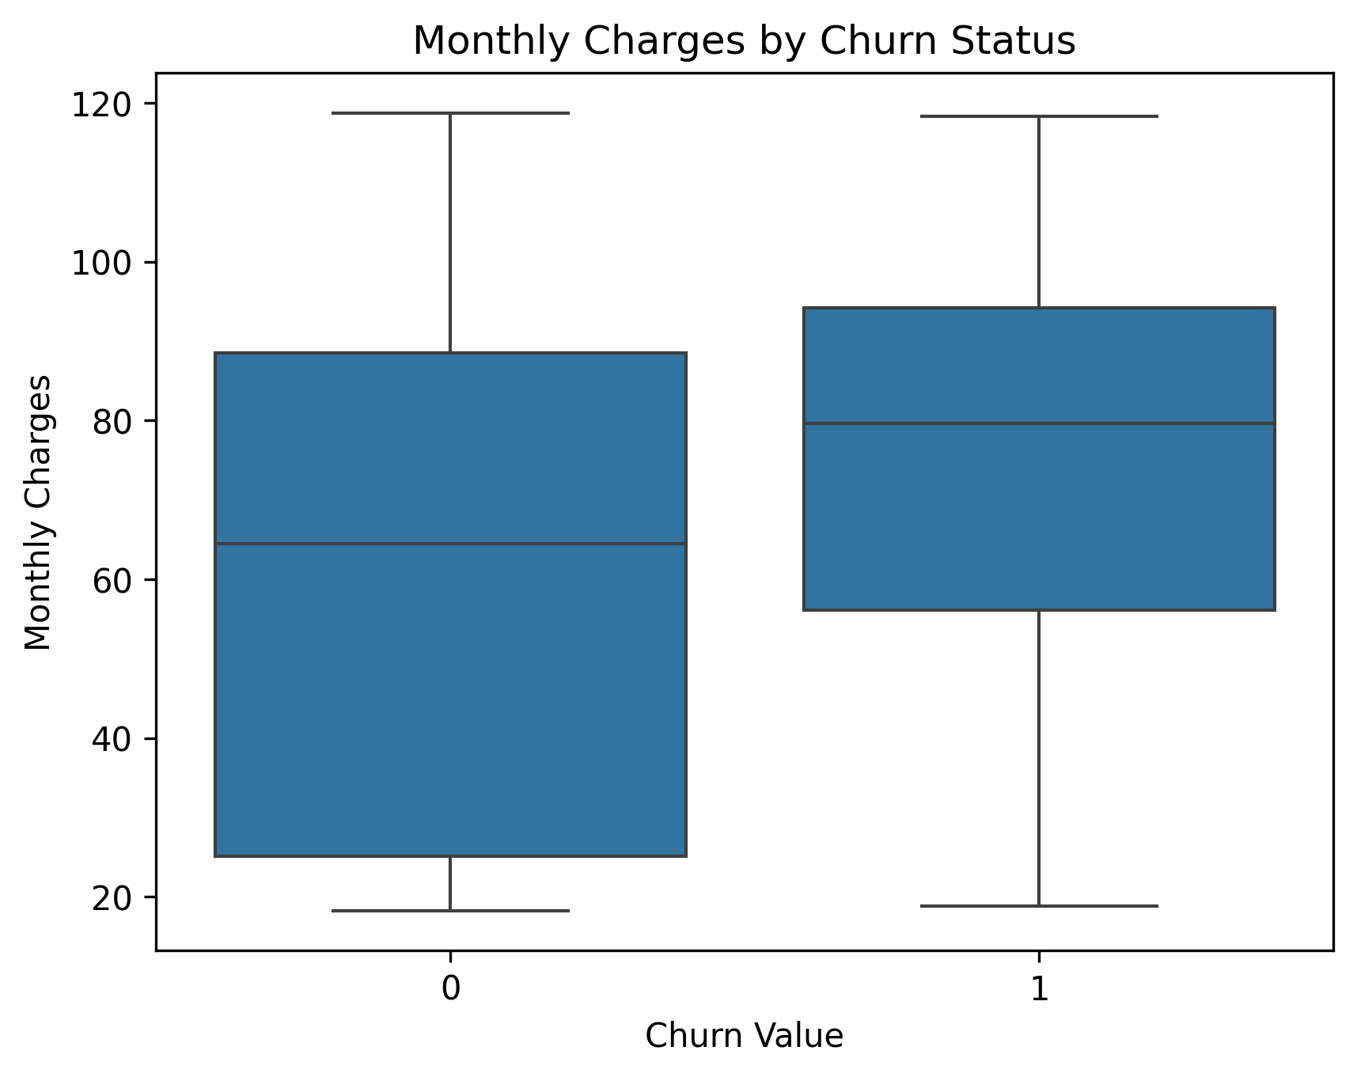
Methods of analysis
(EDA)
Customer Stayed
Customer Left
Customer Stayed
Customer Left

Slide 9
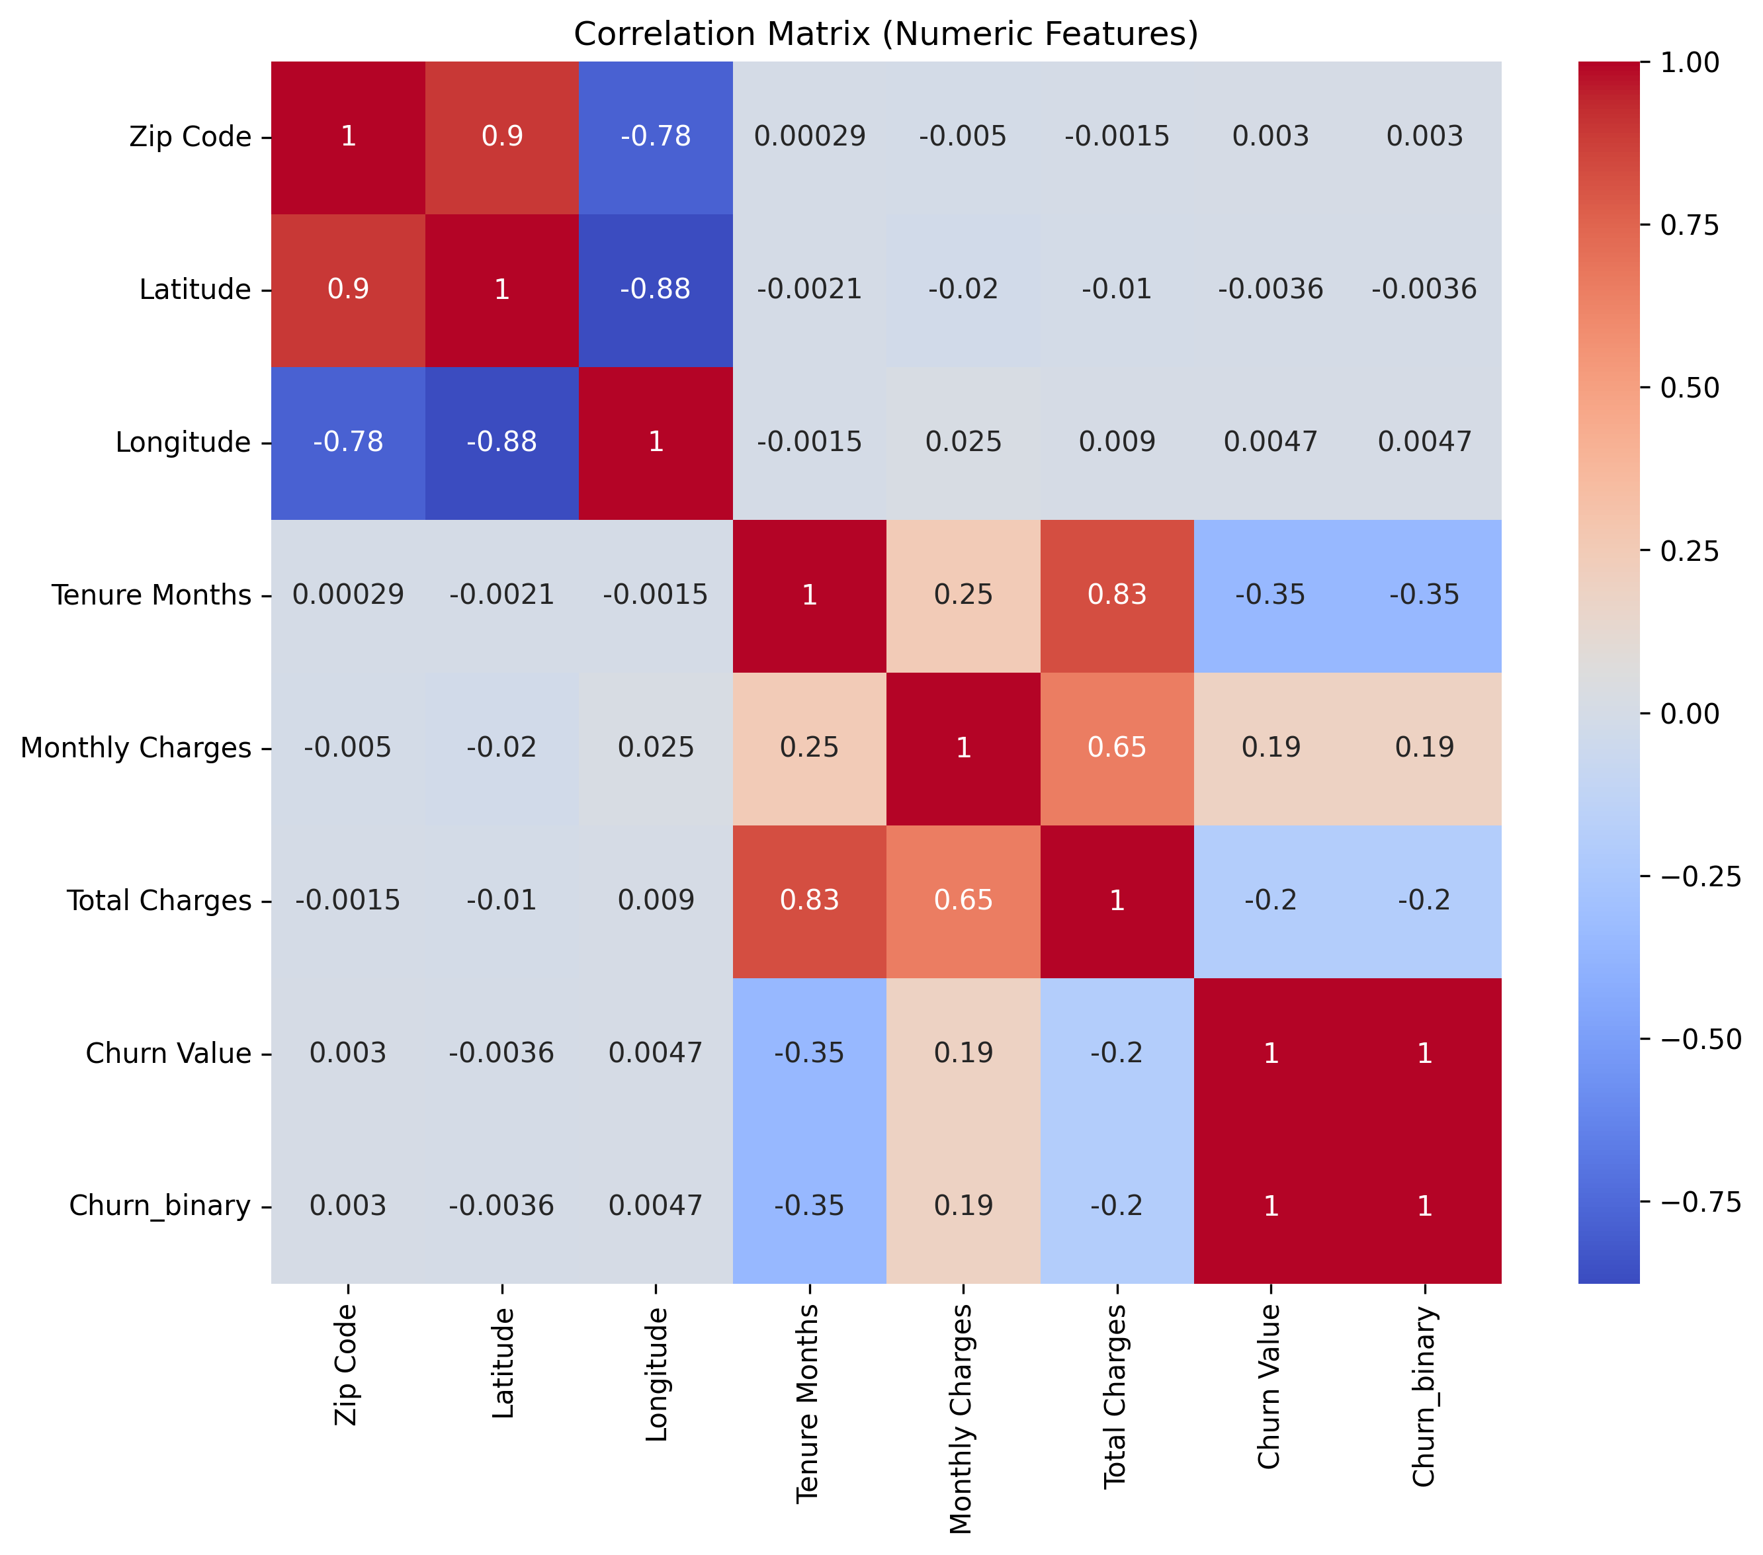
Methods of analysis
(EDA)

Slide 10
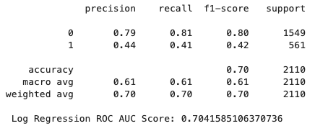
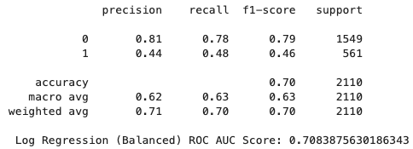
Results and findings
(logistic regression)
Class_weight = ”balanced”

Slide 11
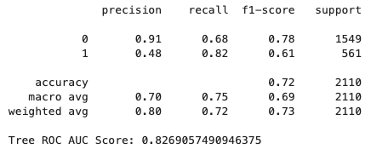
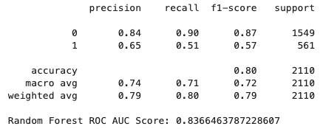
Results and findings
(Trees)
Decision Tree
Random Forest

Slide 12
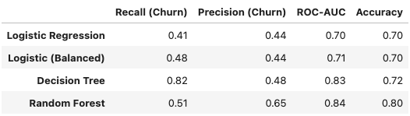
conclusion
Retention strategies should include:
Target month-to-month customers within the first year of account creation.
Prioritize retention campaigns for high monthly charge customers.
Deploy the Random Forest model as it can be used as a risk-ranking system rather than a strict classifier.
Adjust thresholds based on cost tolerance.

